Slide 1

A clinical decision support system for diagnosing and preventing maternal diseases
Gerald Gaitos

Slide 2
Contents
Project Overview
Brief Introduction about Maternal Health
Project Objectives
Specific Aims
MAterials and Methods
Results and Discussion
Conclusion
Future Work and Final Thoughts

Slide 3



Project Overview
Training Model
Expert System
Data

Slide 4






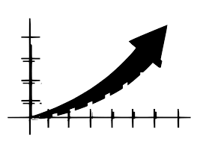

Maternal Health
PRegnancy
Childbirth
Declining Maternal Health
Postnatal
Increasing Maternal mortality

Slide 5
Project Objectives
The main objective of this project was to develop and design a machine learning model that could be utilized as an expert system or a clinical decision support system that would help medical professionals to determine the risk of women having maternal diseases and possibly prevent their debilitating complications.
This project allowed women to be treated timely and effectively, limiting the cases of mortality and morbidity from these preventable diseases.

Slide 6
Specific Aims
Primary: To determine which attributes significantly contribute to high and low maternal health risks.
Secondary: To build training and testing models from Maternal Health Risk Dataset using different classification algorithms.
Tertiary: To develop and design a machine learning model that can serve as an expert system with the highest accuracy and reliability.

Slide 7
Materials and Methods
Maternal Health Risk Dataset.csv - 1,014 instances with 7 attributes (http://archive.ics.uci.edu/ml/datasets/Maternal+Health+Risk+Data+Set#)
Using Python and R programming

Slide 8
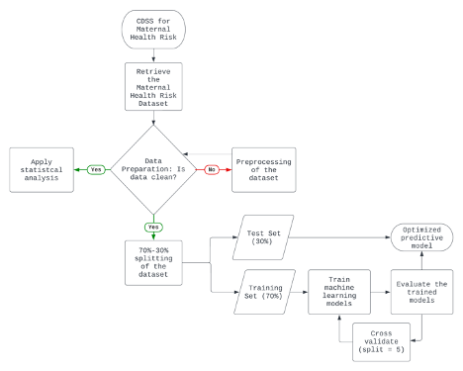
Experimental Setup

Slide 9
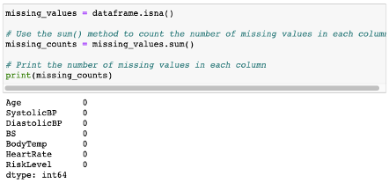

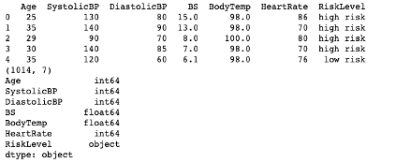
Data Preprocessing
No missing values, noise/outliers, inconsistencies

Slide 10
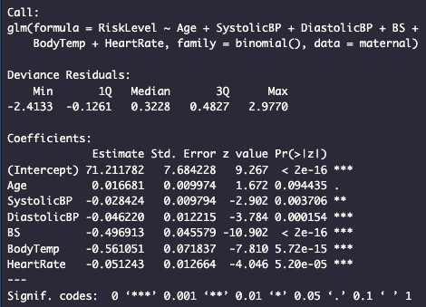
Results and Discussion
Statistical Analysis: General Linear Model
P-value <0.5 attributes

Slide 11
Results and Discussion
Machine Learning Algorithm | Average Cross-validation Score (5 folds) | Accuracy Score | Balanced Accuracy Score
K=4 nearest neighbors | 0.79 | 0.94 | 0.89
Decision tree | 0.76 | 0.91 | 0.88
Naïve Bayes | 0.74 | 0.56 | 0.66
Support vector machine (kernel=poly) | 0.76 | 0.64 | 0.71
Logistic Regression | 0.76 | 0.65 | 0.62
Developing a model:
Best performing model: K=4 nearest neighbor
Range of ave. cross-validation score: 0.74 to 0.79

Slide 12
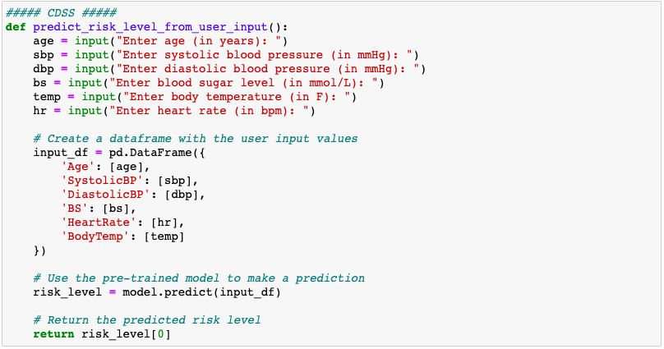
Results and Discussion
Developing an expert System:
Running data from the original dataset

Slide 13
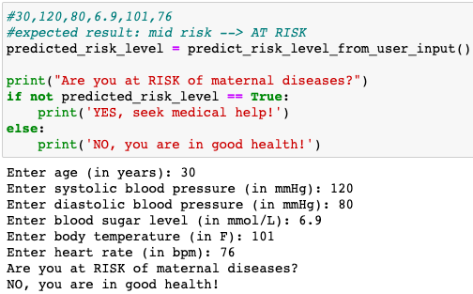
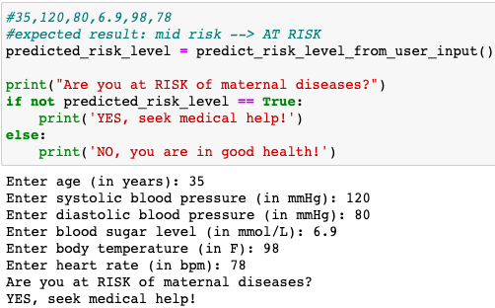
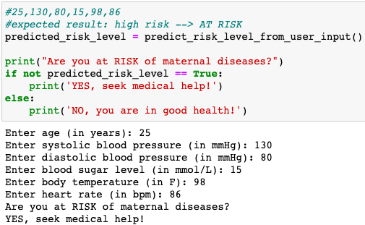

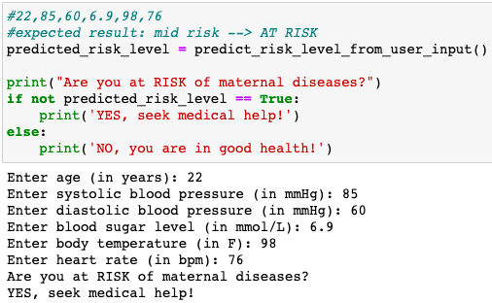
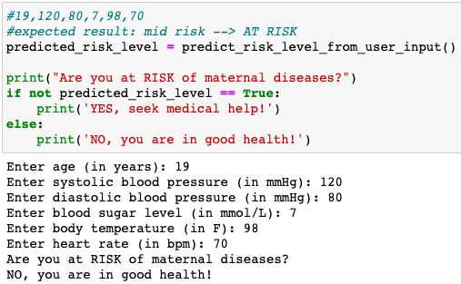
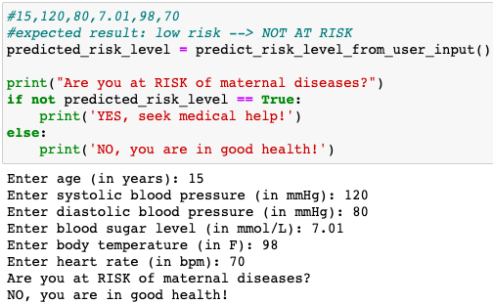

Slide 14
Conclusion
From this analysis, the attributes SystolicBP, DiastolicBP, BS, BodyTemp, and HeartRate showed signification associations with the outcome RiskLevel relating to increased risk of acquiring maternal diseases.
Furthermore, it was found through machine learning that the K=4 nearest neighbor model had the highest accuracy for the classification and prediction of the risk levels.
Therefore, it could be utilized effectively as an expert system. This project would benefit women with better health outcomes and healthcare professionals to prevent the increase in maternal diseases and eliminate the decreasing trend in maternal health.

Slide 15
Future Work and Final Thoughts
For future work, using a larger dataset to improve the cross-validation, accuracy, and balanced accuracy scores would be beneficial. Incorporating other machine learning algorithms to compare and attain the best-performing machine learning model.

Slide 16
References
Ahmed M., Kashem M.A., Rahman M. & Khatun S. (2020). Maternal Health Risk Dataset [Dataset]. UCI Machine Learning Repository. Retrieved March 26, 2023, from http://archive.ics.uci.edu/ml/datasets/Maternal+Health+Risk+Data+Set#
Ahmed M., Kashem M.A., Rahman M. & Khatun S. (2020). Review and Analysis of Risk Factor of Maternal Health in Remote Area Using the Internet of Things (IoT). Lecture Notes in Electrical Engineering, vol 632. Springer, Singapore. https://doi.org/10.1007/978-981-15-2317-5_30
Ansari, N., Manalai, P., Maruf, F., Currie, S., Stekelenburg, J., van Roosmalen, J., Kim, Y. & Tappis, H. (2019). Quality of care in early detection and management of pre-eclampsia/eclampsia in health facilities in Afghanistan. BMC Pregnancy and Childbirth 19 (36). https://doi.org/10.1186/s12884-018-2143-0
Garovic, V. D. et al. (2021 December 15). Hypertension in Pregnancy: Diagnosis, Blood Pressure Goals, and Pharmacotherapy: A Scientific Statement From the American Heart Association. Hypertension 2022, 79, e21-e41. https://doi.org/10.1161/HYP.0000000000000208
Hunt, P. & Bueno de Mesquita, J. (2010, January 1). Reducing Maternal Mortality: The contribution of the right to the highest attainable standard of health. University of Essex. Retrieved April 3, 2023, from https://www.unfpa.org/sites/default/files/pub-pdf/reducing_mm.pdf
Mugyenyi, G. R. et al. (2021 March 11). Quality of vital sign monitoring during obstetric hospitalizations at a regional referral and teaching hospital in Uganda: an opportunity for improvement. Pan Afr Med J 2021, 38, 252. doi: 10.11604/pamj.2021.38.252.21749
Taylor, L. (2023). Maternal health is now deteriorating in much of the world, UN report shows. BMJ 2023, 380, 454. doi:10.1136/bmj.p454
World Health Organization. (2014). Maternal mortality. World Health Organization. Retrieved April 29, 2023, from https://apps.who.int/iris/bitstream/handle/10665/112318/WHO_RHR_14.06_eng.pdf
World Health Organization. (2023). Maternal health. World Health Organization. Retrieved April 29, 2023, from https://www.who.int/health-topics/maternal-health#tab=tab_1

